Slide 1
How can constraint theory be applied to proteins?
Microscopic interactions do not cleanly separate into strong and weak
Jacobs, et. al., p357 in “Rigidity Theory and Applications”,
Eds. M.F. Thorpe and P.M. Duxbury, Kluwer-Academic (1999).
Strong
Schematic Microscopic Interaction Strength Scale
Weak
U_{mol} = U_{CF} + U_{BB} + U_{SB} + U_{HB} + U_{DA}+ U_{other}
van der Waals, electrostatic, and other non-bonding forces
Depth of a potential well
Dihedral angle torsion forces
Hydrogen bond range
Salt bridges
Covalent bond bending forces
Covalent bond stretching central forces

Slide 2
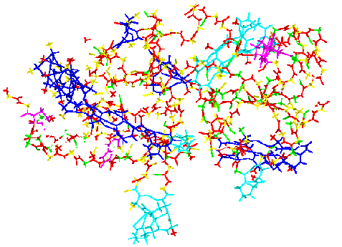
Network Rigidity: Applied to Proteins
To be or not to be a constraint?
μ Energy cutoff
Strong
Weak
U_{mol} = U_{CF} + U_{BB} + U_{SB} + U_{HB} + U_{DA}
Modeled as constraints
defining rigid clusters
Unconstrained
μ = -1.80 kcal/mol
246 hydrogen bonds modeled as a constraint
Jacobs, et. al., Proteins 44, 150 (2001)
Jacobs & Thorpe, US Patent # 6014449

Slide 3
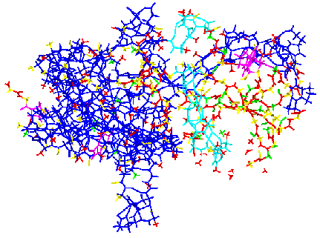
Network Rigidity: Applied to Proteins
To be or not to be a constraint?
μ Energy cutoff
Strong
Weak
U_{mol} = U_{CF} + U_{BB} + U_{SB} + U_{HB} + U_{DA}
Modeled as constraints
defining rigid clusters
Unconstrained
μ = -0.50 kcal/mol
366 hydrogen bonds modeled as a constraint
Jacobs, et. al., Proteins 44, 150 (2001)
Jacobs & Thorpe, US Patent # 6014449

Slide 4
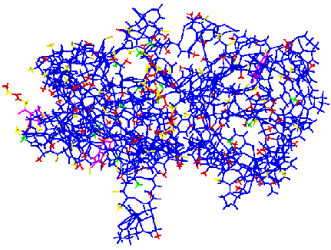
Network Rigidity: Applied to Proteins
To be or not to be a constraint?
μ Energy cutoff
Strong
Weak
U_{mol} = U_{CF} + U_{BB} + U_{SB} + U_{HB} + U_{DA}
Modeled as constraints
defining rigid clusters
Unconstrained
μ = -0.01 kcal/mol
461 hydrogen bonds modeled as a constraint
Jacobs, et. al., Proteins 44, 150 (2001)
Jacobs & Thorpe, US Patent # 6014449

Slide 5
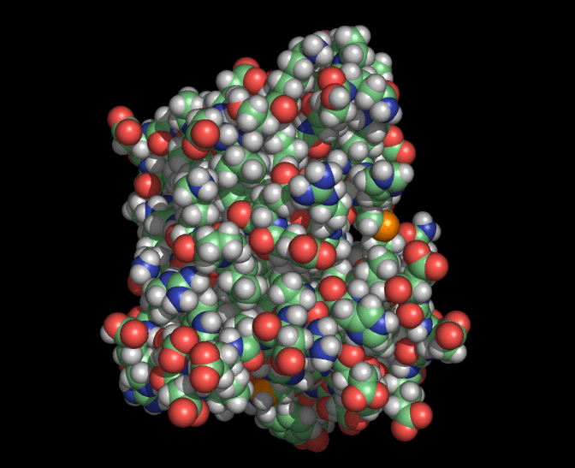
Introduction to Protein Flexibility
Example of Protein Motion
Dihydrofolate reductase (DHFR)
Proteins are not rigid bodies. They are flexible and have many types of motions from small amplitude vibrations to large scale conformational rearrangements to folding/unfolding.
Animation from M.F. Thorpe

Slide 6
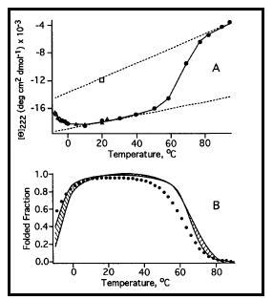
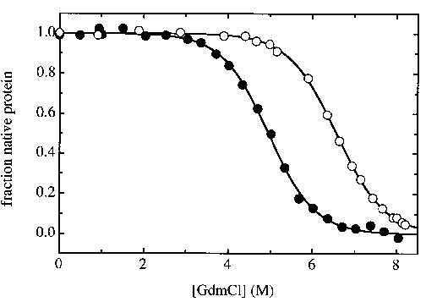
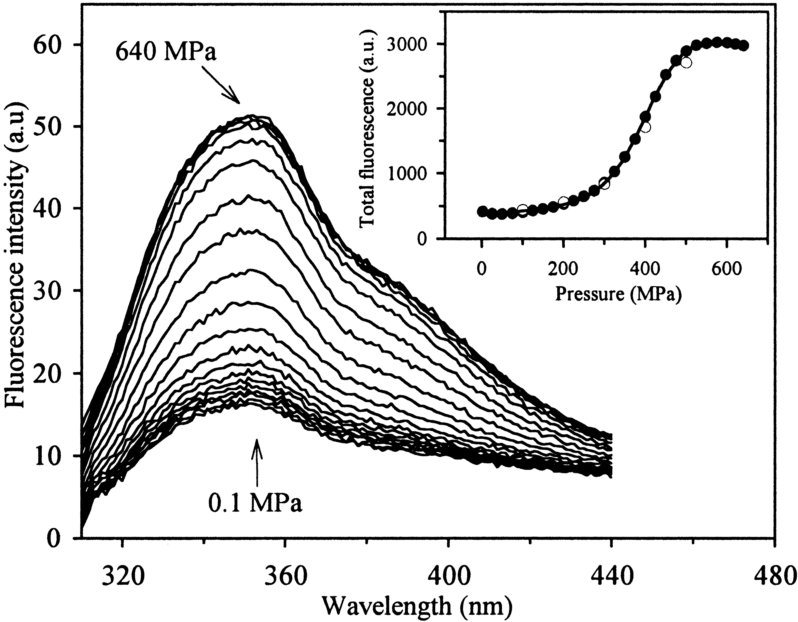
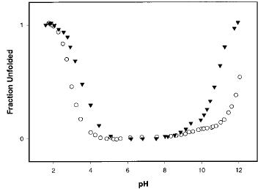
Protein Thermodynamic Stability
Dependence on thermodynamic/solvent conditions and sequence
Temperature induced denaturation
R.M. Ballew, et al., PNAS 93 5759 (1996)
[co-solute] induced denaturation
G. Pappenberger, Nature: Struct. Biol. 8, 452-458 (2001)
examples of how to denature a protein
(randomly selected)
sequence
dependence
pH induced denaturation
Spector and Raleigh. JMB. 276 479-489, (1998)
pressure induced denaturation
Torrent, et. al., Biochemistry, 38, 15952-15961, (1999)

Slide 7
Protein Function Paradigm
Use computational models to quantitatively describe nature
Sequence
Structure
FUNCTION
Sequence
Structure
Flexibility
Dynamics
FUNCTION
Stability
Biology perspective
Physics perspective

Slide 8
Computational Biology
Theoretical Modeling + Computational Methods = Predictions
schematic
pH
Optimal function
depending on:
sequence
recognition site
denaturant
pressure
etc
Phase boundary line
depending on:
sequence
bound ligand
denaturant
pressure
etc
Folded
T
Big Picture Goals
Understand relationships between protein structure, flexibility, stability and function
Develop models to facilitate computational targeted-drug design predictions
Design high efficiency enzyme catalysts for specified environmental conditions

Slide 9
Insight into Thermodynamic Stability
A two state model
G = H - TS
G
Helix
Coil
T
J.A. Schellmann, J. Phys. Chem. 62, 1485-1492 (1958)

Slide 10
Thermodynamic Stability: A Two State Model
Enthalpy-entropy compensation
G = H - TS
G
Helix
Coil
Helix
Rigid, low number of
conformational DOF
Flexible, high number
of conformational DOF
Coil
-TS
H
H
-TS
H
-TS
Low T
Transition
High T
T
J.A. Schellmann, J. Phys. Chem. 62, 1485-1492 (1958)

Slide 11
Protein Thermodynamic Stability
Commonly employed free energy decomposition schemes
Single residue
mutation
Linearity assumption of total free energy
G_{protein} − G_{ref-state} = Σ ΔG = Σ (ΔH – TΔS)
Calorimetry Measurements give: ΔG, ΔH, ΔS from model compound transfer

Slide 12
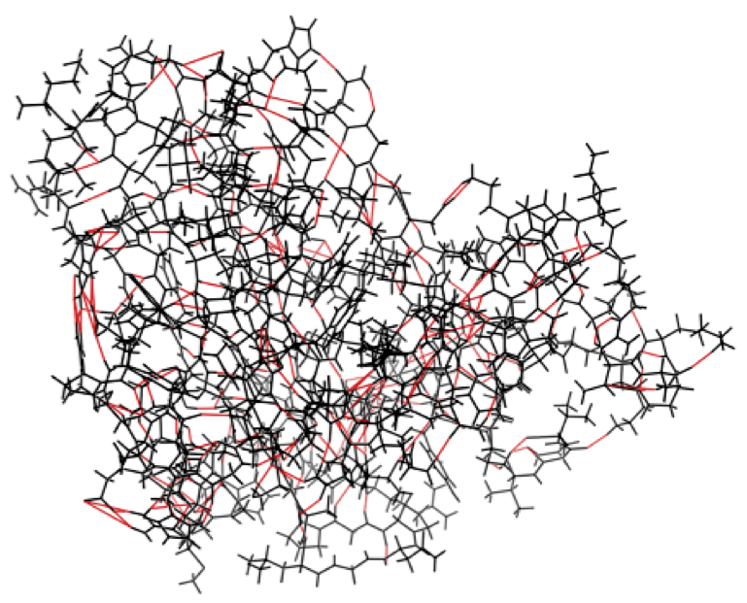
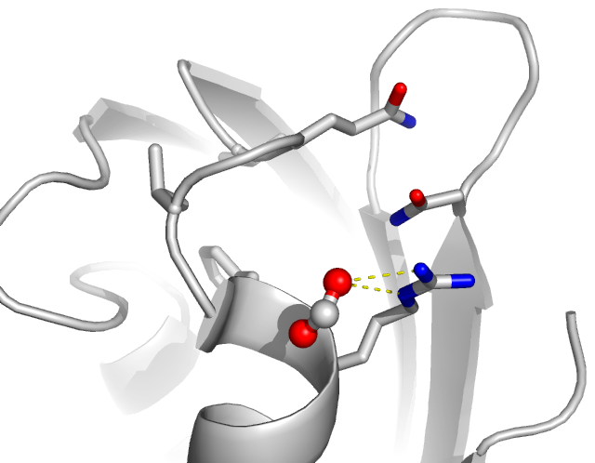
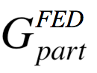
Free Energy Decomposition and its Reconstitution
Non-additivity derives from molecular cooperativity
Ledger of free energy
contributions from
specific interactions
part_{a}
part_{b}

Slide 13
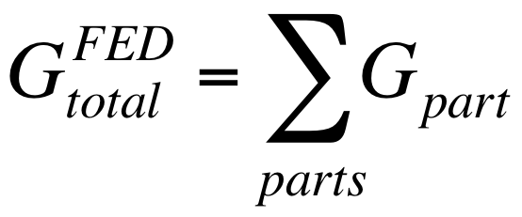
Free Energy Decomposition and its Reconstitution
Non-additivity derives from molecular cooperativity
Free Energy Reconstitution (FER)
FED
Non-additive parts
Hidden Thermodynamics
Prevents additive rules from reproducing macromolecular free energies.
Hidden Thermodynamics of Mutant
Proteins, Gao, Kuczera, Tidor and
Karplus, Science 244, 1069 (1989).
Additivity Principles in Biochemistry,
Dill, J Biol Chem 272, 701-704 (1997).
Decomposition of the Free Energy of a System in Terms of Specific Interactions,
Mark and van Gunsteren, J Mol Biol 240, 167 (1994).
“In regard to the detailed separation of free energy components, we must acknowledge
that the hidden thermodynamics of a protein will, unfortunately, remain hidden.”

Slide 14
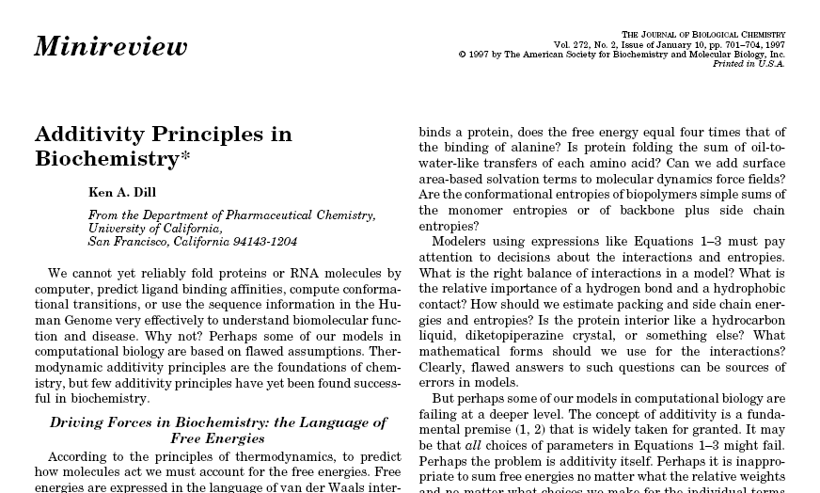
Free Energy Decomposition Schemes
Component entropies are generally non-additive in biochemistry

Slide 15
Non-additivity in Entropy Derives From Correlated Motions
An alternative to a normal mode approach is needed
☑ H_{protein} = H_{ref-state} + Σ ΔH Total enthalpy is always additive
☒ S_{protein} = S_{ref-state} + Σ ΔS Total entropy is generally non-additive
Q: When is entropy non-additive?
A: Subsystems are strongly coupled
Ex: Correlations lead to less disorder
Consider: S = − k_{B} Σ p_{s} ln(p_{s})
Let E ≡ an ensemble of English literature
Let p_{s} ≡ probability for s-th type letter
S_{E} < − k_{B} Σ p_{s} ln(p_{s})
Q: When is entropy additive?
A: Subsystems are non-cooperative
Ex: No coupling between subsystems Consider: Z_{total} = ∏ Z(s)
⇒ S_{total} = Σ S(s)
Due to correlations in letters because words are mostly restricted to spelling rules, sentences mostly restricted to grammar rules, etc.
A clever trick:
Define system using orthogonal coordinates describing microstates,
such as vibrational normal modes.
s → normal mode index

Slide 16
Non-additivity in Entropy Derives From Correlated Motions
An alternative to a normal mode approach is needed
☑ H_{protein} = H_{ref-state} + Σ ΔH Total enthalpy is always additive
☒ S_{protein} = S_{ref-state} + Σ ΔS Total entropy is generally non-additive
Q: When is entropy non-additive?
A: Subsystems are strongly coupled
Ex: Correlations lead to less disorder
Consider: S = − k_{B} Σ p_{s} ln(p_{s})
Let E ≡ an ensemble of English literature
Let p_{s} ≡ probability for s-th type letter
S_{E} < − k_{B} Σ p_{s} ln(p_{s})
Q: When is entropy additive?
A: Subsystems are non-cooperative
Ex: No coupling between subsystems Consider: Z_{total} = ∏ Z(s)
⇒ S_{total} = Σ S(s)
Computationally too Expensive!
Due to correlations in letters because words are mostly restricted to spelling rules, sentences mostly restricted to grammar rules, etc.
A clever trick:
Define system using orthogonal coordinates describing microstates,
such as vibrational normal modes.
s → normal mode index

Slide 17
Distance Constraint Model (DCM)
Restoring utility of the free energy decomposition paradigm
A NEW PERSPECTIVE
D.J. Jacobs,et. al., Network rigidity at finite temperature: Relationships between thermodynamic stability, the nonadditivity of entropy, and cooperativity in molecular systems. Physical Reviews E. 68, 061109 1-21 (2003)
The DCM resolves the problem of non-additivity
Identifying correlations between degrees of freedom from network rigidity enables rapid and good estimates for conformational entropy.
Constraint Theory
and
Free Energy
Decomposition
atomic level
molecular structure
DCM
Distance Constraint
Model
“I never satisfy myself until I can make a mechanical model of a thing. If I can make a mechanical model I can understand it”! --- Lord Kelvin

Slide 18
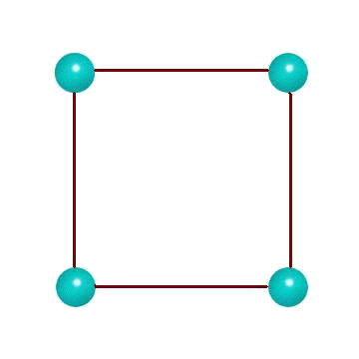
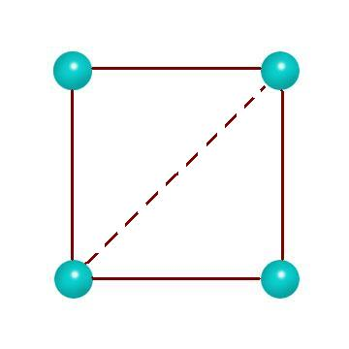
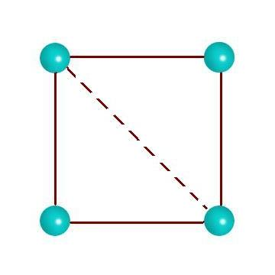
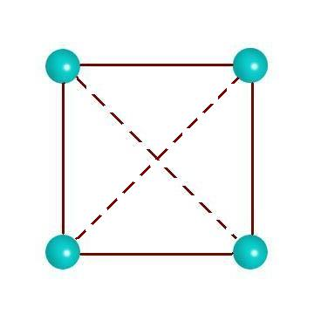
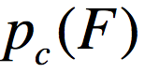
Tao of the DCM
Free energy reconstitution consistent with mechanical constraints
Jacobs, et al. Proteins (2001) 44:150
Jacobs, et al. Phys. Rev. E (2003) 68:061109
Jacobs & Dallakyan (2005) Biophysical J. 88:903
ΔH = 0
ΔS = 0
ΔH = -ε
ΔS = -δ
ΔH = -ε
ΔS = -δ
ΔH = -ε + -ε
ΔS = -δ + 0
Regarding NETWORK RIGIDITY as a mechanical interaction accounts for NON-ADDITIVITY IN ENTROPY

Slide 19
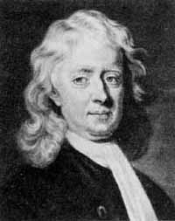
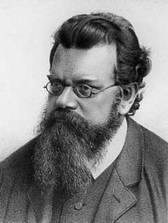
End of Part 1
Network rigidity is a fundamental mechanical property that directly links protein stability, flexibility and dynamics
Newtonian
Mechanics
Boltzmann
Statistics
Part 2: Exact Numerical Solutions for the DCM
Simple toy model
Beta-hairpin to coil transition
Transfer matrix method under Maxwell constraint counting
Alpha-helix to coil transition (in water)
Alpha-helix to coil transition (in mixed solvent)
Work supported by:
NSF-DMR 96-32182, Research Corporation CC5141, NIH-SBIR R43 GM58337,
NIH-S06 GM48680-0952, NIH-R01 GM 073082, NIH-R21 HL093531, NIH-ARRA-073082, NIH-S10 SRR026514, MedImunne, Inc. , Charlotte Research Institute (CRI)
Center for Biomedical Engineering and Science (CBES)

